Slide 1


UNIT 1; With you from the start
Self-check 1

Slide 2
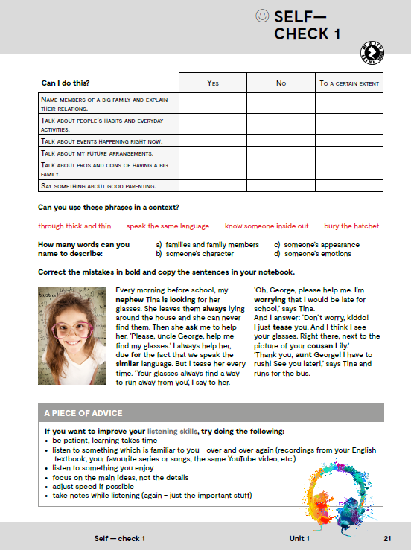

Slide 3
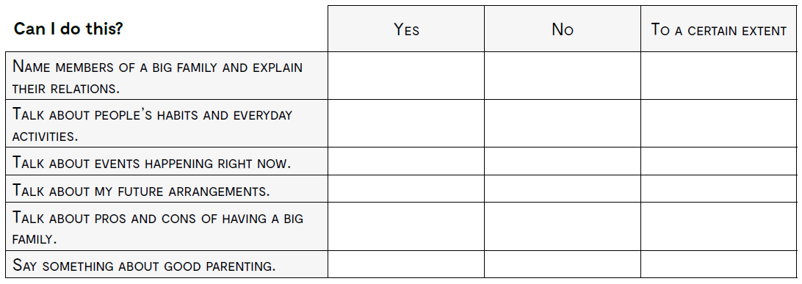
Can you do this?

Slide 4
through thick and tin kroz dobro i zlo
speak the same language dobro se razumjeti
know someone inside out nekoga jako dobro poznati
bury the hatchet zakopati sjekiru

Slide 6
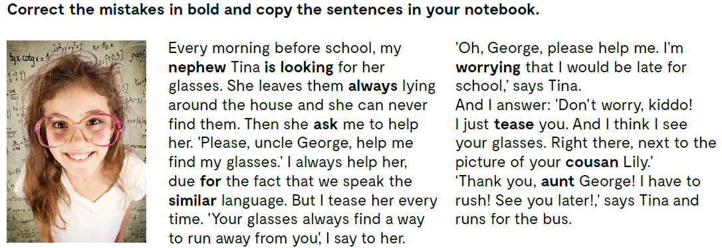
niece
looks
She always leaves
asks
to
same
worried
am teasing
cousin
Uncle George

Slide 7

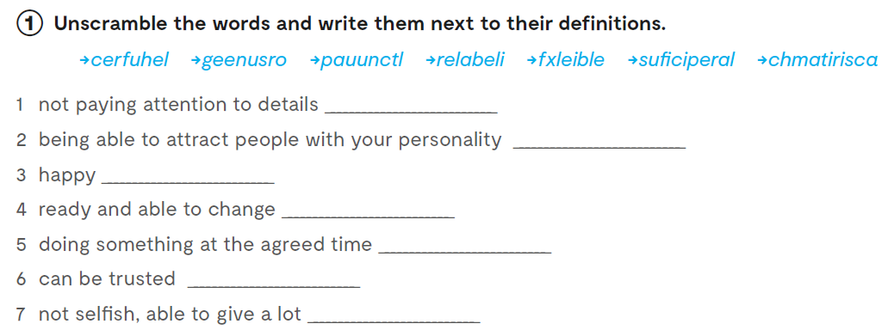
Workbook, p 18.
superficial
charismatic
cheerful
flexible
punctual
reliable
generous

Slide 8
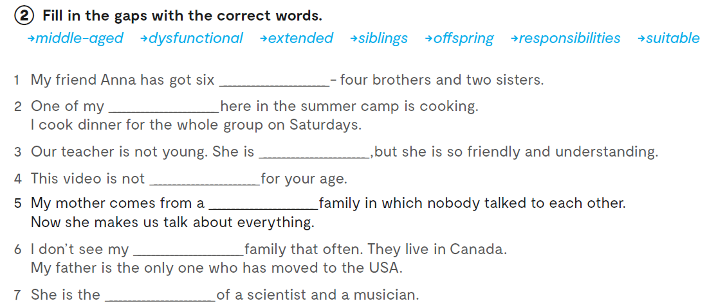
siblings
responsibilites
middle-aged
suitable
dysfunctional
extended
offspring

Slide 9
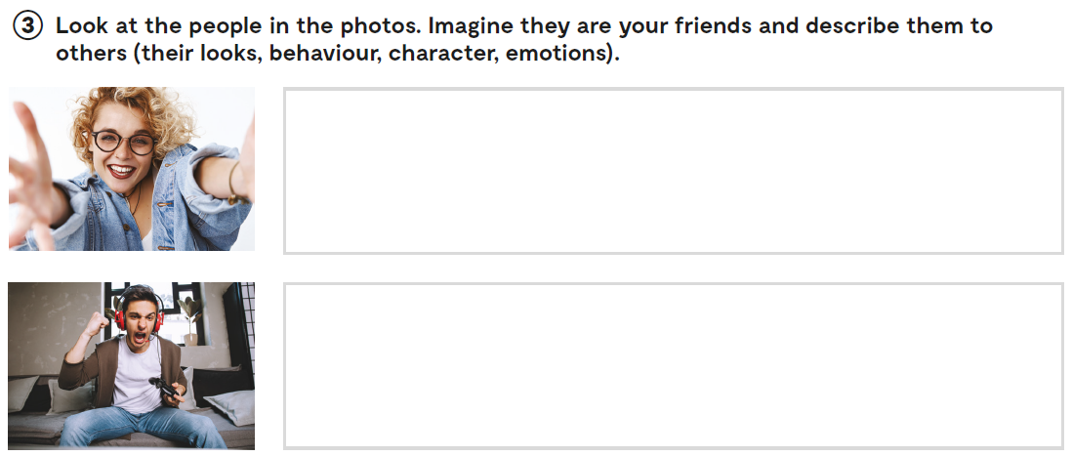
She’s cheerful and adventurous...

Slide 10
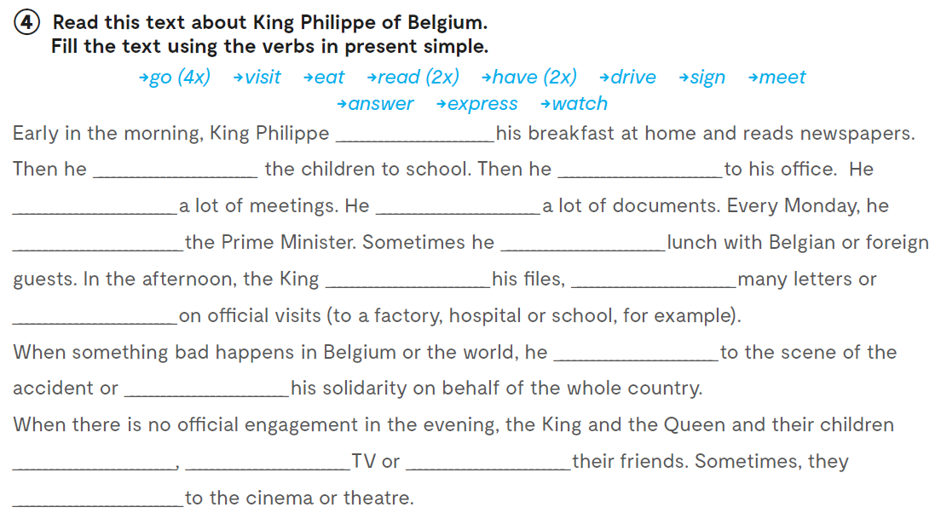
eats
drives
goes
has
signs
meets
has
reads
answers
goes
goes
expresses
read
watch
visit
go

Slide 11
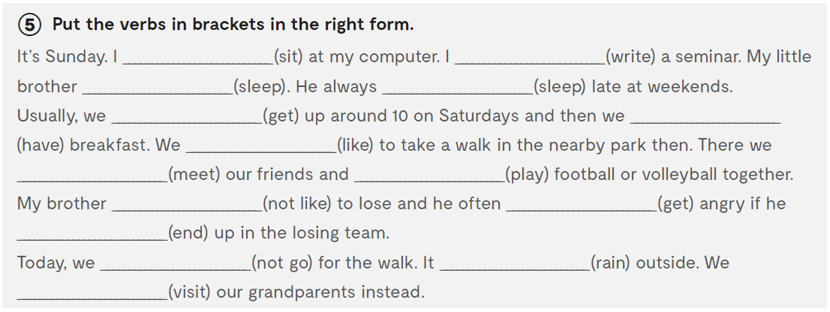
am sitting
am writing
is sleeping
sleeps
get up
have
like
meet
play
doesn’t like
gets
ends
are not going
is raining
am visiting

Slide 12
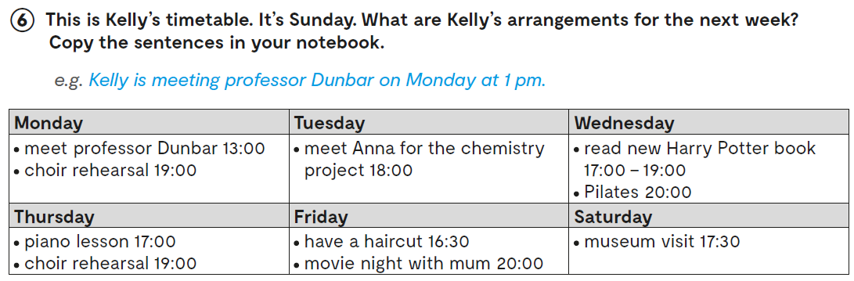
She’s having a haircut on Friday at 4.30 pm.

Slide 13
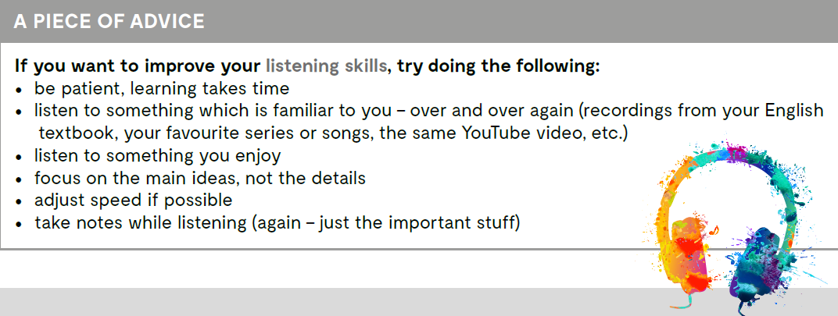
Let’s practise!
https://learningapps.org/watch?v=poa363epa20
https://wordwall.net/play/880/979/218

